Slide 1
Protein Structure Prediction Using Machine Learning
By:
Menna khaled
221000165

Slide 2
Project Objective
Predicting the Average B Factor
Comparing between ML Models
Selecting the Best Model out of the 3 used
Deploying at the end using Streamlit

Slide 3
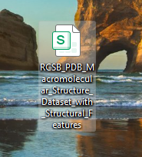
Dataset Description
RCSB PDB Dataset was used
2. The chosen target was Average B Factor
3. Protein structural features

Slide 4
Data Preprocessing
first handling Missing Values
Removing Unnecessary Columns
Converting Data Types
Then Data Cleaning

Slide 5
Feature Engineering: Structure Complexity
A new feature was created to improve model performance
ombines secondary structure elements: Helix + Sheet + Coil
Structure Complexity = Helix + Sheet + Coil
Represents the overall structural complexity of proteins

Slide 6
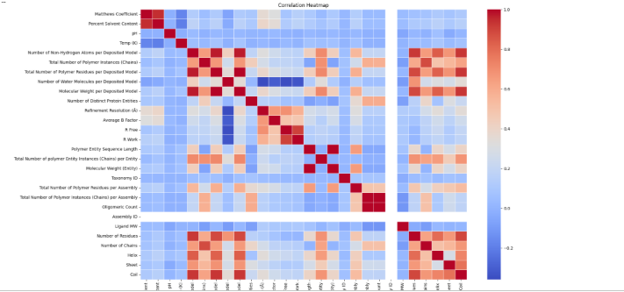
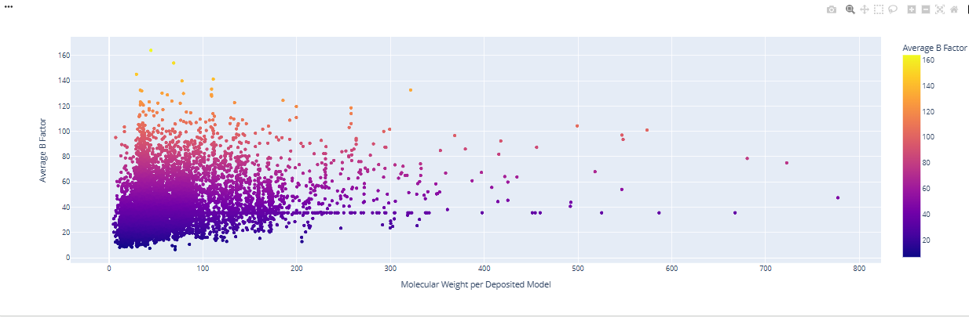
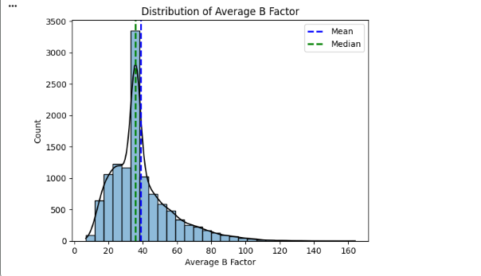
Exploratory Data Analysis
3. Scatter Plot (Molecular Weight vs Average B Factor)
1. Correlation Heatmap
2. Histogram of Average B Factor

Slide 7
Feature Selection
The model was trained using 13 structural features along with the engineered feature Structure Complexity.
Selected Features examples:
1) Matthews Coefficient
2) Molecular Weight
3) Sequence Length
+ Structure Complexity:

Slide 8
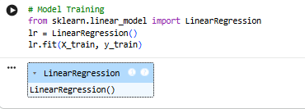
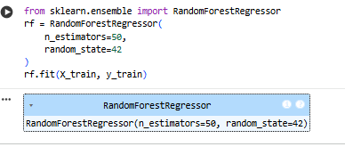
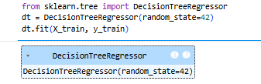
Machine Learning Models
I used 3 machine learning models:
1.Linear Regression
2.Decision Tree Regressor
3.Random Forest Regressor

Slide 9



Model Results
The results than showed:
Linear Regression R² = 0.388
Decision Tree R² = 0.213
Random Forest R² = 0.584
And that means that Random forest got the highest predictive performance between the three models.

Slide 10

Hyperparameter Tuning
Best Parameters:
max_depth = 10
n_estimators = 50

Slide 11
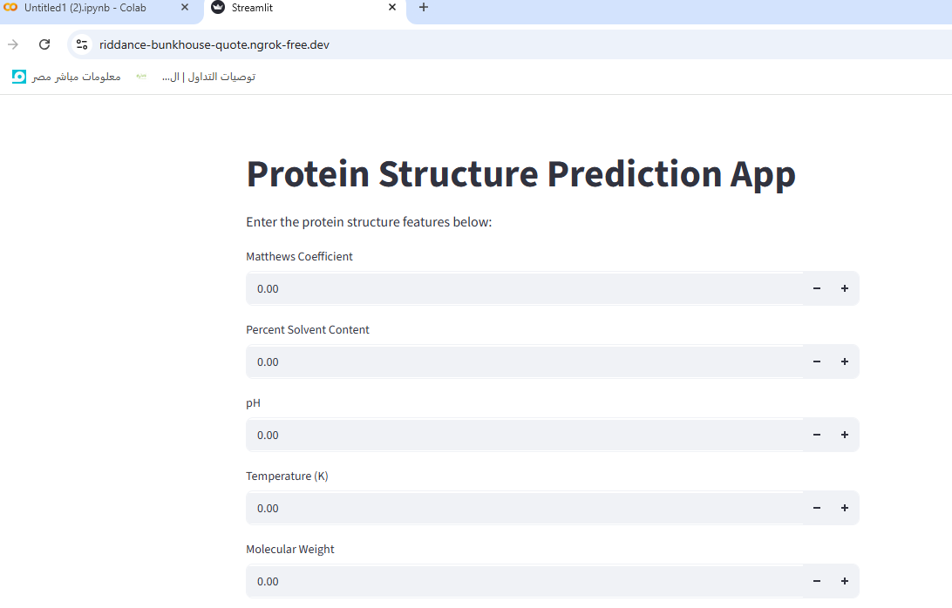
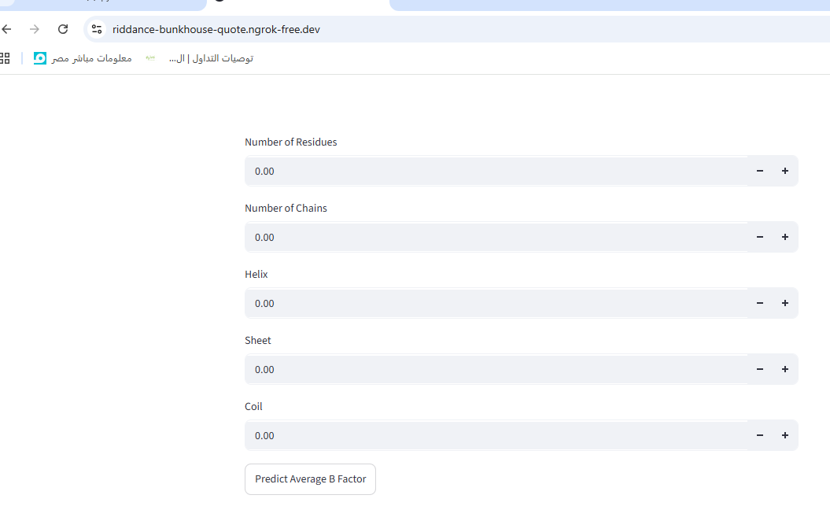
Deployment
The last step which is deployment by Streamlit.

Slide 12
Conclusion
In conclusion, this project used machine learning to predict protein B-factor values. Random Forest achieved the best performance (R² = 0.584) and was selected as the final model. A Streamlit app was developed to enable real-time prediction, showing the practical use of ML in bioinformatics.

Slide 13
Thank you.

